Slide 1
Community ART for Retention in Zambia: Service delivery preferences among stable patients on ART - A discrete choice experiment
Centre for Infectious Disease Research in Zambia (CIDRZ)
In partnership with the Zambian Ministry of Health
Sponsor: Bill & Melinda Gates Foundation
19th September 2018
Collaborators: James Cooke University, Johns Hopkins, UAB, UCSF, UNZA

Slide 2
Benefits of differentiated service delivery (DSD)
Decrease visits
Decongest clinic
Less waiting time at the facility
Buddy pick-up
Peer support
Decrease stigma
Notes:
There are many types of differentiated service delivery (dsd) models, which contain some or all of these benefits. For example, giving Multi-month prescriptions decreases visit frequency and decongests clinics;

Slide 3
Gaps in knowledge
Which DSD elements do patients prefer?
How do preferences vary?
What model should we choose for which setting?
Notes:
Although there is increasing evidence that DSD models have similar or better patient outcomes with regard to retention in care, there is comparatively little evidence supporting which elements of the model to choose for which setting, or which model features patients prefer and drive adherence, for example we don’t know if patients prefer reduced visit frequency to fast-tracking through the clinic - if given a choice. Knowing this is particularly important when health centers don’t have the resources to implement a number of different types of models.

Slide 4
Methods
Attribute: | Levels:
Location of ARV pickup | Clinic
 | Community
Frequency of ARVs pick up | Every month
 | Every 3 months
Time spent in picking up ARVs | 1 hour total
 | 3 hours total
 | 6 hours total
Time spent in seeing the doctor | 1 hour total
 | 3 hours total
 | 5 hours total
Adherence Counseling | Individual counseling
 | Small group counseling (< 6 people)
 | Large group counseling (>15 people)
Buddy System | Buddy system in place
 | No buddy system in place
Notes:
In the DCE we asked patients to choose from different combinations of these differentiated service delivery attributes and attribute levels over 14 questions. We then used the choices that patients made to help determine what the main patient preferences are – using mixed logit regression models

Slide 5
Demographic characteristics
Characteristics (N = 486) |  | N (%)
Male sex |  | 198 (41%)
Age (years; median and interquartile range) |  | 39 (33-46)
Marital status | Never married | 54 (11%)
 | Married | 294 (60%)
 | Living separately or divorced | 76 (16%)
 | Widowed | 62 (13%)
Education level | None | 120 (25%)
 | Some primary school | 251 (52%)
 | Completed primary school | 76 (16%)
 | Higher education | 39 (8%)
Employment status | Employed steady wages | 105 (22%)
 | Self employed | 213 (44%)
 | Housewife | 65 (13%)
 | Unemployed* | 103 (21%)
Clinic setting | Urban | 411 (85%)
 | Rural | 75 (15%)
Notes:
The DCE was conducted in 486 patients most of whom were married , had some primary school education, were self employed and currently receiving care in an urban clinic.

Slide 6
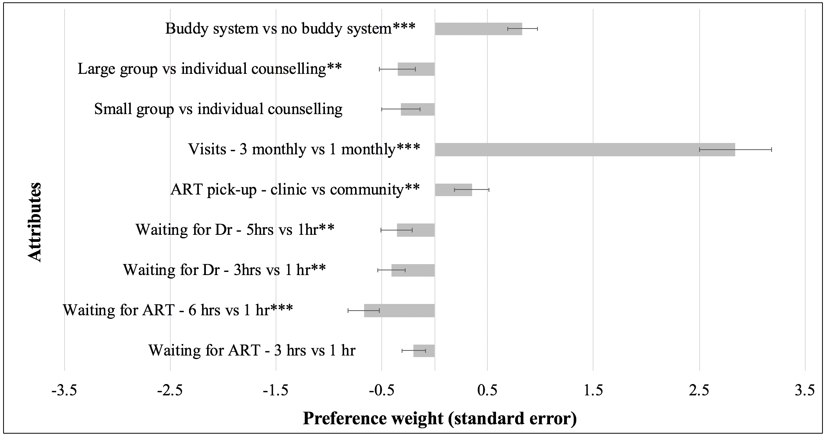
Results: Patient preferences
Notes:
The mixed logit regression model shows positive preferences (what patients want) on the right of the line and negative preference (what patients do not want ) on the left of the line. The results showed that overwhelmingly patients had a preference for 3 monthly visits over 1 monthly visits (they had an almost 3 times greater preference for 3 monthly visits over 1 monthly visits).
They also had some preference of a buddy system to no buddy system, and slight preference for collecting their ART in the clinic rather than in the community.

Slide 7
Variation in preference by setting
Attributes |  | Preference weight | SE | p-value
Location of ART pick-up - clinic vs community | Rural participants | -0.74 | 0.37 | 0.049
 | Urban participants | 1.32 | 0.50 | <0.001
Visits 3 monthly vs 1 monthly | Rural participants | 0.95 | 0.39 | 0.015
 | Urban participants | 2.19 | 0.50 | <0.002
Notes:
Preferences did not vary by age, sex but did by health care setting, we found that:
Rural participants wanted to get their ART in the community where as urban participants preferred collecting ART in the clinic
We also found that it was urban participants who had the strongest preference for 3 monthly instead of 1 monthly clinic visits, with rural participants only moderately so

Slide 8
Conclusions
Overall preferences vary
Reducing frequency of visits - most valued
Urban participants
Want to get ART at the clinic
Rural participants
Want to get ART in the community
Notes:
What this DCE showed is that of all the options we presented to these patients – reducing the frequency of visits was the most highly valued aspect and that preferences varied for rural and urban participants,
This supports the idea that when we design DSD we need to consider
that the models should be specific to the needs of patients in different settings
there should be room for options of different models of care for patients, and
if resources are limited or there are logistical challenges, reducing visit frequency alone may still allow for the provision of patient centered care and long term retention while simultaneously decongesting clinics.

Slide 9
Thank You
Questions?
We would like to thank the Zambian Ministry of Health and all participating patients and health workers.

